Slide 1

Computer vision
Reporter： Yuanhong Guo

Slide 2
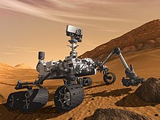
Definition
What is computer vision?
Computer vision is a simulation of biological vision using computers and related equipment. Its main task is to obtain three-dimensional information of the corresponding scene by processing the collected pictures or videos, just like humans and many other kinds of creatures do every day.

Slide 3
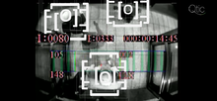
Definition
What is computer vision?
Computer vision is the knowledge about how to use cameras and computers to obtain the data and information we need, the subject being photographed. To put it vividly, it is to install eyes (cameras) and brains (algorithms) on the computer so that the computer can perceive the environment.

Slide 4
History
The history of computer vision.
In the late 1960s, computer vision began at universities which were pioneering artificial intelligence.
In 1966, it was believed that this could be achieved through a summer project, by attaching a camera to a computer and having it "describe what it saw".

Slide 5
History
The history of computer vision.
The next decade saw studies based on more rigorous mathematical analysis and quantitative aspects of computer vision.
Recent work has seen the resurgence of feature-based methods, used in conjunction with machine learning techniques and complex optimization frameworks.

Slide 6
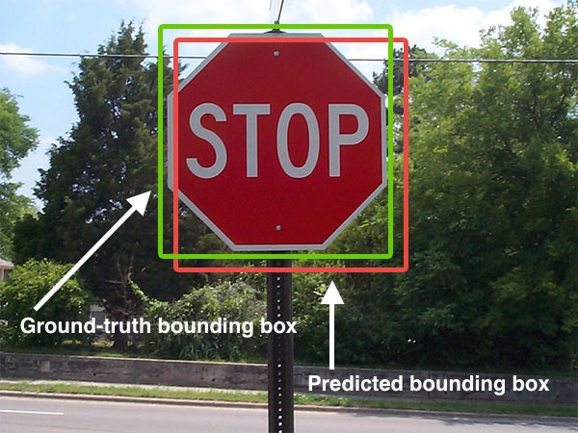
Issues
Computer vision research issues
Identify
A classic problem shared by computer vision, image processing and machine vision is to determine whether a set of image data contains a specific object, image feature or motion state. Such as simple geometric pattern recognition, face recognition.

Slide 7
Issues
Computer vision research issues
Motion
The monitoring of object motion based on sequence images includes many types, such as:
Self-motion: monitor the three-dimensional rigid motion of the camera.
Image tracking: Track moving objects.

Slide 8
Issues
Computer vision research issues
Scene reconstruction and Image restoration
Given two or more images or a video of a scene, scene reconstruction seeks to build a computer model.
The goal of image restoration is to remove noise in the image.

Slide 9
System
Computer vision system
Image acquisition
Pretreatment
Feature extraction
Advanced processing
Detect segmentation

Slide 10
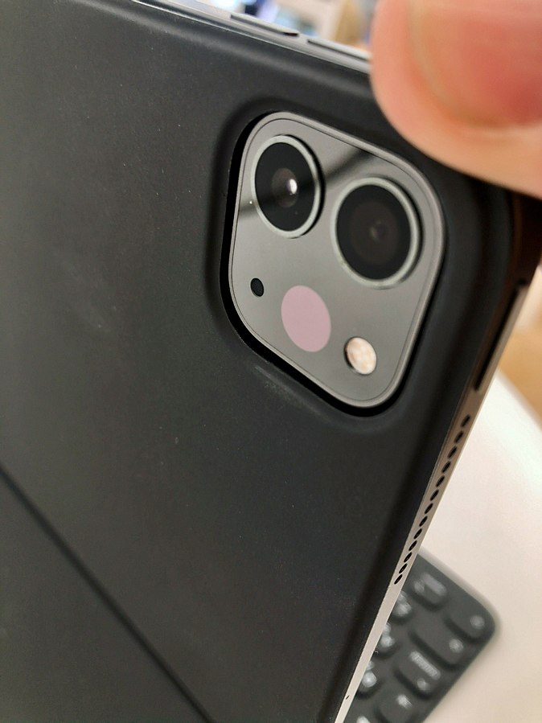
Hardware
Computer vision hardware
There are many kinds of computer vision systems; however, all of them contain these basic elements: a power source, at least one image acquisition device (camera, ccd, etc.), a processor, and control and communication cables or some kind of wireless interconnection mechanism.

Slide 11
Hardware
Computer vision hardware
In addition, a practical vision system contains software, as well as a display in order to monitor the system.
Furthermore, a completed system includes many accessories such as camera supports, cables and connectors.

Slide 12
Hardware
Computer vision hardware
As of 2016, vision processing units are emerging as a new class of processor, to complement CPUs and graphics processing units (GPUs) in this role.

Slide 13
Hardware
Computer vision hardware
THANKS

